Slide 1
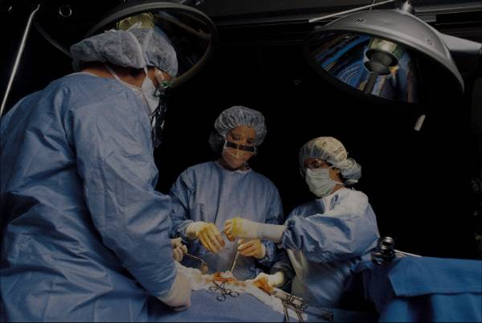
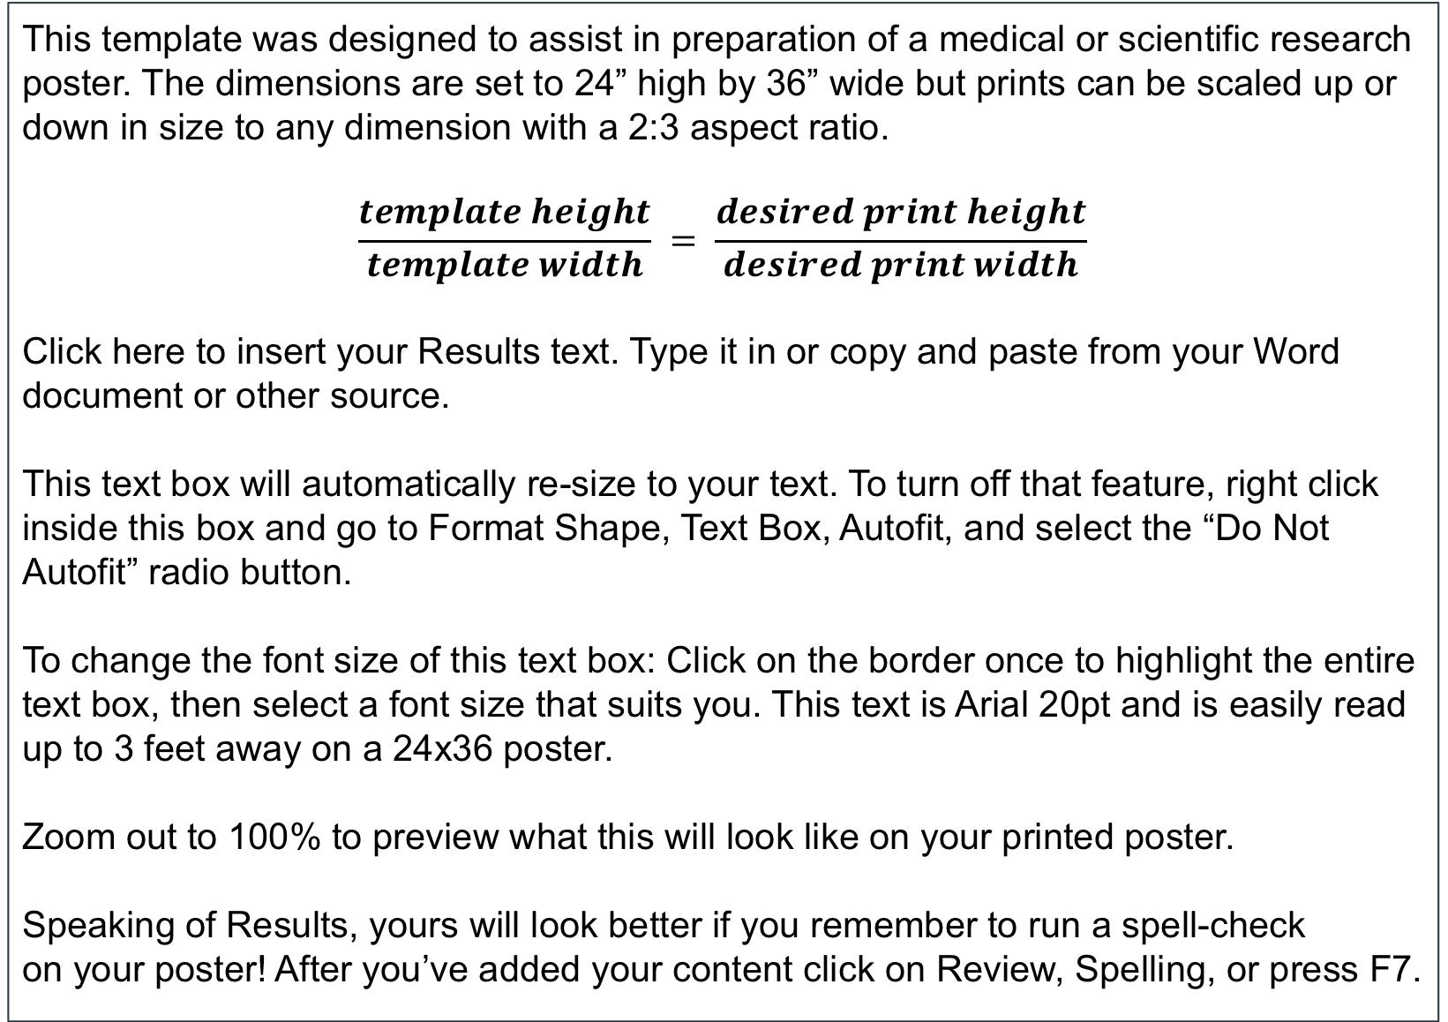
Use This Space for the Title
(Times New Roman Font)
First Name Last Name, MD, PhD
Abstract (Times New Roman Font)
Methods and Materials
Click here to insert your Abstract text. Type it in or copy and paste from your Word document or other source.
This text box will automatically re-size to your text. To turn off that feature, right click inside this box and go to Format Shape, Text Box, Autofit, and select the “Do Not Autofit” radio button.
To change the font size of this text box: Click on the border once to highlight the entire text box, then select a font size that suits you. This text is Arial 20pt and is easily read up to 3 feet away on a 24x36 poster, and up to 6 feet away on a 48x72 poster.
Zoom out to 100% (for 24x36) or 200% (for 48x72) to preview what this will look like on your printed poster.
Click here to insert your Methods and Materials text. Type it in or copy and paste from your Word document or other source.
This text box will automatically re-size to your text. To turn off that feature, right click inside this box and go to Format Shape, Text Box, Autofit, and select the “Do Not Autofit” radio button.
To change the font size of this text box: Click on the border once to highlight the entire text box, then select a font size that suits you. This text is Ariali 20pt and is easily read up to 3 feet away on a 24x36 poster, and up to 6 feet away on a 48x72 poster.
Zoom out to 100% (for 24x36) or 200% (for 48x72) to preview what this will look like on your printed poster.
Chart 1. Label in 16pt Calibri.
Introduction
Results
Discussion
This template was designed to assist in preparation of a medical or scientific research poster. The dimensions are set to 24” high by 36” wide but prints can be scaled up or down in size to any dimension with a 2:3 aspect ratio.
$$\frac{template height}{template width} = \frac{desired print height}{desired print width}$$
Click here to insert your Results text. Type it in or copy and paste from your Word document or other source.
This text box will automatically re-size to your text. To turn off that feature, right click inside this box and go to Format Shape, Text Box, Autofit, and select the “Do Not Autofit” radio button.
To change the font size of this text box: Click on the border once to highlight the entire text box, then select a font size that suits you. This text is Arial 20pt and is easily read up to 3 feet away on a 24x36 poster.
Zoom out to 100% to preview what this will look like on your printed poster.
Speaking of Results, yours will look better if you remember to run a spell-check on your poster! After you’ve added your content click on Review, Spelling, or press F7.
Click here to insert your Results text. Type it in or copy and paste from your Word document or other source.
This text box will automatically re-size to your text. To turn off that feature, right click inside this box and go to Format Shape, Text Box, Autofit, and select the “Do Not Autofit” radio button.
To change the font size of this text box: Click on the border once to highlight the entire text box, then select a font size that suits you. This text is Arial 20pt and is easily read up to 3 feet away on a 24x36 poster, and up to 6 feet away on a 48x72 poster.
Zoom out to 100% (for 24x36) or 200% (for 48x72) to preview what this will look like on your printed poster.
Speaking of Results, yours will look better if you remember to run a spell-check on your poster! After you’ve added your content click on Review, Spelling, or press F7.
Click here to insert your Discussion text. Type it in or copy and paste from your Word document or other source.
This text box will automatically re-size to your text. To turn off that feature, right click inside this box and go to Format Shape, Text Box, Autofit, and select the “Do Not Autofit” radio button.
To change the font size of this text box: Click on the border once to highlight the entire text box, then select a font size that suits you. This text is Arial 20pt and is easily read up to 3 feet away on a 24x36 poster, and up to 6 feet away on a 48x72 poster.
Zoom out to 100% (for 24x36) or 200% (for 48x72) to preview what this will look like on your printed poster.
Conclusions
Click here to insert your Conclusions text. Type it in or copy and paste from your Word document or other source.
This text box will automatically re-size to your text. To turn off that feature, right click inside this box and go to Format Shape, Text Box, Autofit, and select the “Do Not Autofit” radio button.
To change the font size of this text box: Click on the border once to highlight the entire text box, then select a font size that suits you. This text is Ariali 20pt and is easily read up to 3 feet away on a 24x36 poster, and up to 6 feet away on a 48x72 poster.
Zoom out to 100% (for 24x36) or 200% (for 48x72) to preview what this will look like on your printed poster.
Table 1. Label in 16pt Calibri.
 | Heading | Heading | Heading
Item | 800 | 790 | 4001
Item | 356 | 856 | 290
Item | 228 | 134 | 238
Item | 954 | 875 | 976
Item | 324 | 325 | 301
Total | 199 | 137 | 186
Figure 1. Label in 16pt Calibri.
Figure 2. Label in 16pt Calibri.
Contact
References
<your name>
<your organization>
Email:
Website:
Phone:

